Slide 1



THANK YOU

Slide 2


Feedback is important
https://forms.office.com/e/U48qzpcvLE

Slide 3

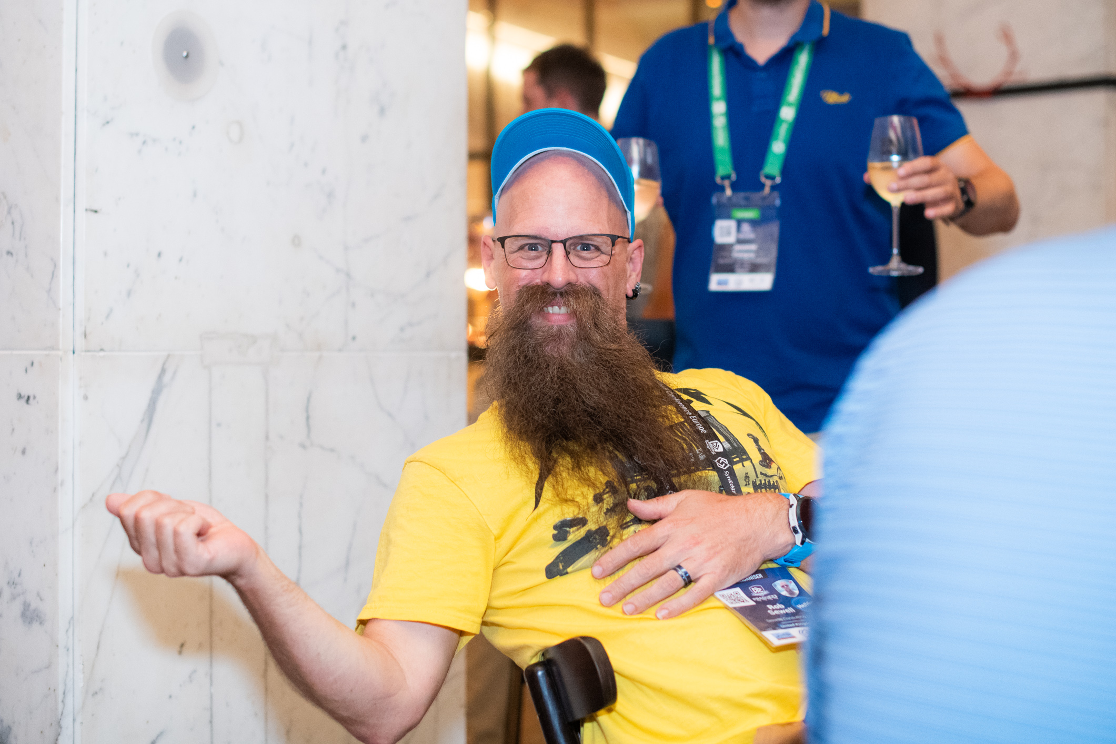
We’ll get in touch for your portraits!

Slide 4
Your PSConfEU 2023 mug
Mug, mug mug, mug mug, mug mug, mug mug, mug mug, mug mug, mug mug, mug mug, mug
MUG!
(downstairs) until 4PM.

Slide 5
What worked, what did not…
Wi-Fi
Follow Along sessions
Venue
Classroom Layout
Session Cancellations
First lunch
9AM start on day 3
Please tell us…!

Slide 6
Feedback is important
https://forms.office.com/e/U48qzpcvLE

Slide 7
Session Recordings
YES! ☺

Slide 8
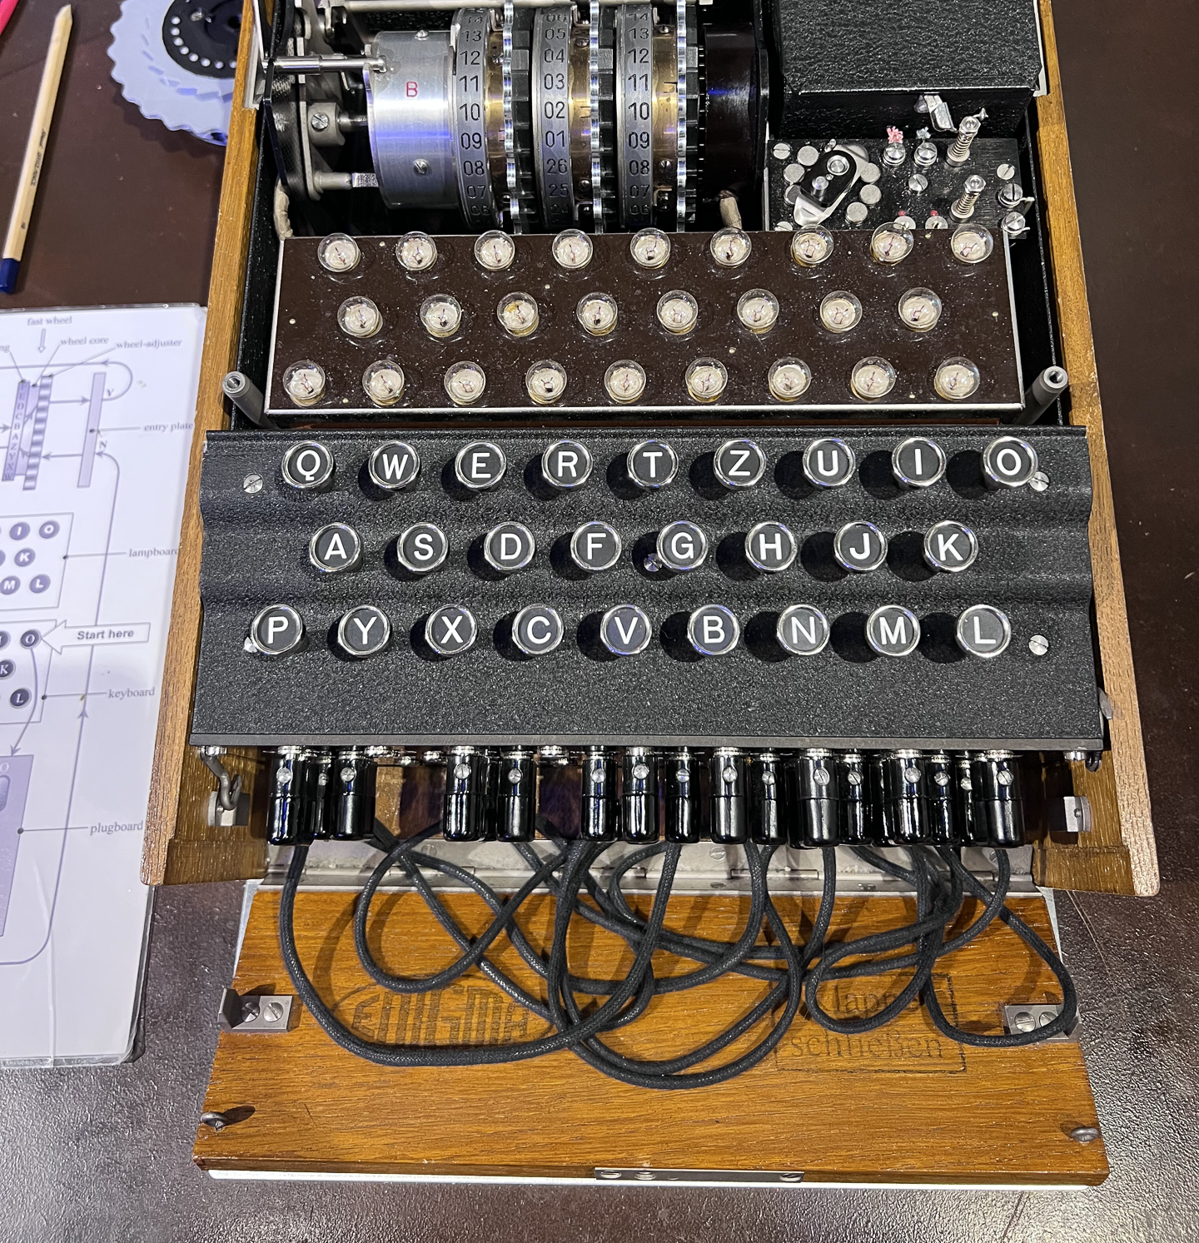
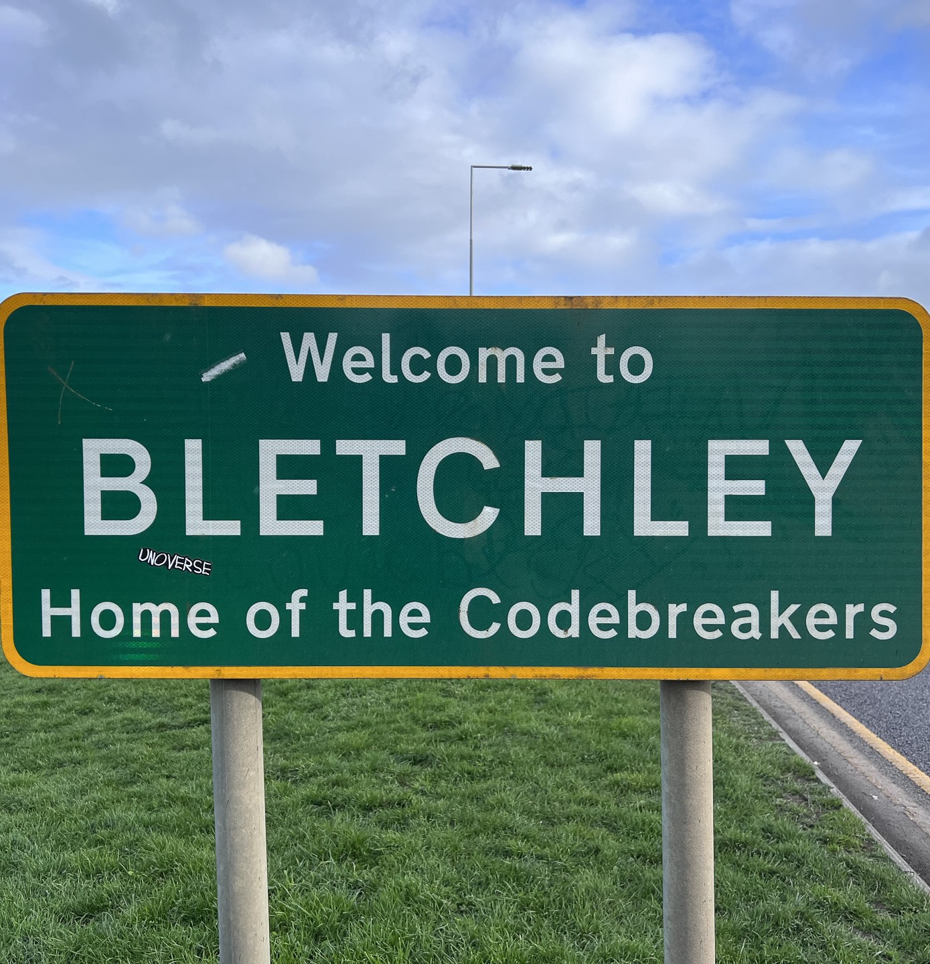

Slide 9
Codebreaker contest
## Load enigma (quick'n dirty)
irm https://raw.githubusercontent.com/thorstenbutz/PSEnigma/main/PSEnigmaDraft.ps1 | iex
$encodedMessage = @'
WKYKX MTXAN BFUFD DBTIL YYRQW
OZKCT DTZCS SUNNS HATWO OXZOG
KGGON UIFUG WJSAU ACSYI SYBAD
KBBIF UKHFL
'@
## Decrypt the code
$testEnigma = [Enigma]::new()
$testEnigma.setup(2, (3,1,2), '???', (21,6,23), 'AB KI CD EF GH XY VW JL MP QZ')
translate -text $encodedMessage -e $testEnigma | deblur | groupify -wordmode
Message key?

Slide 10
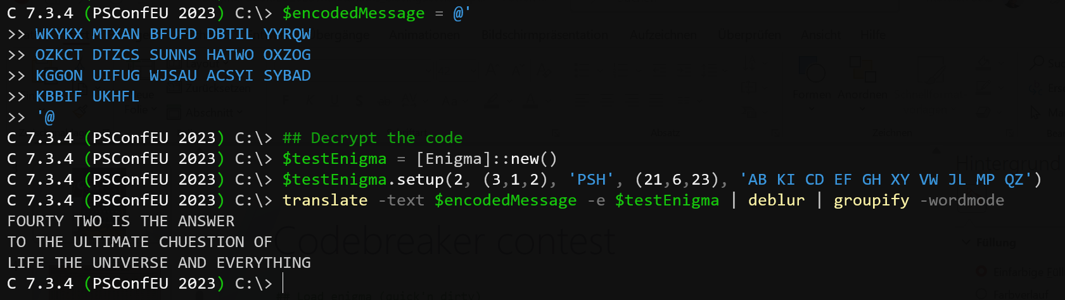

Slide 11



What’s next?
Follow us
Submit Feedback
Session Recordings
MiniCon
Mentorship Program

Slide 12


Slide 13
Feedback is critical
https://forms.office.com/e/U48qzpcvLE

Slide 14



October 24th, 2023 Late afternoon CET

Slide 15

Aspiring Speaker Mentorship program
What aspirants should expect?
Anatomy of a Session
How do we select sessions?
The CFP Agenda
A good Abstract
Bad abstracts
Preparing the Session
How much work is it?

Slide 16
PSConfEU 2024 ?
Definitely maybe
We don’t know where, or when
Call for Speakers:
Mid-October to Mid-December
Answer by ~5th of January 2024
Speakers are announced as they confirm

Slide 17
You ARE the Community ?
Keep it welcoming
Contribute!
Feedback
Time
User group
Content
Ask for help, and offer yours

Slide 18
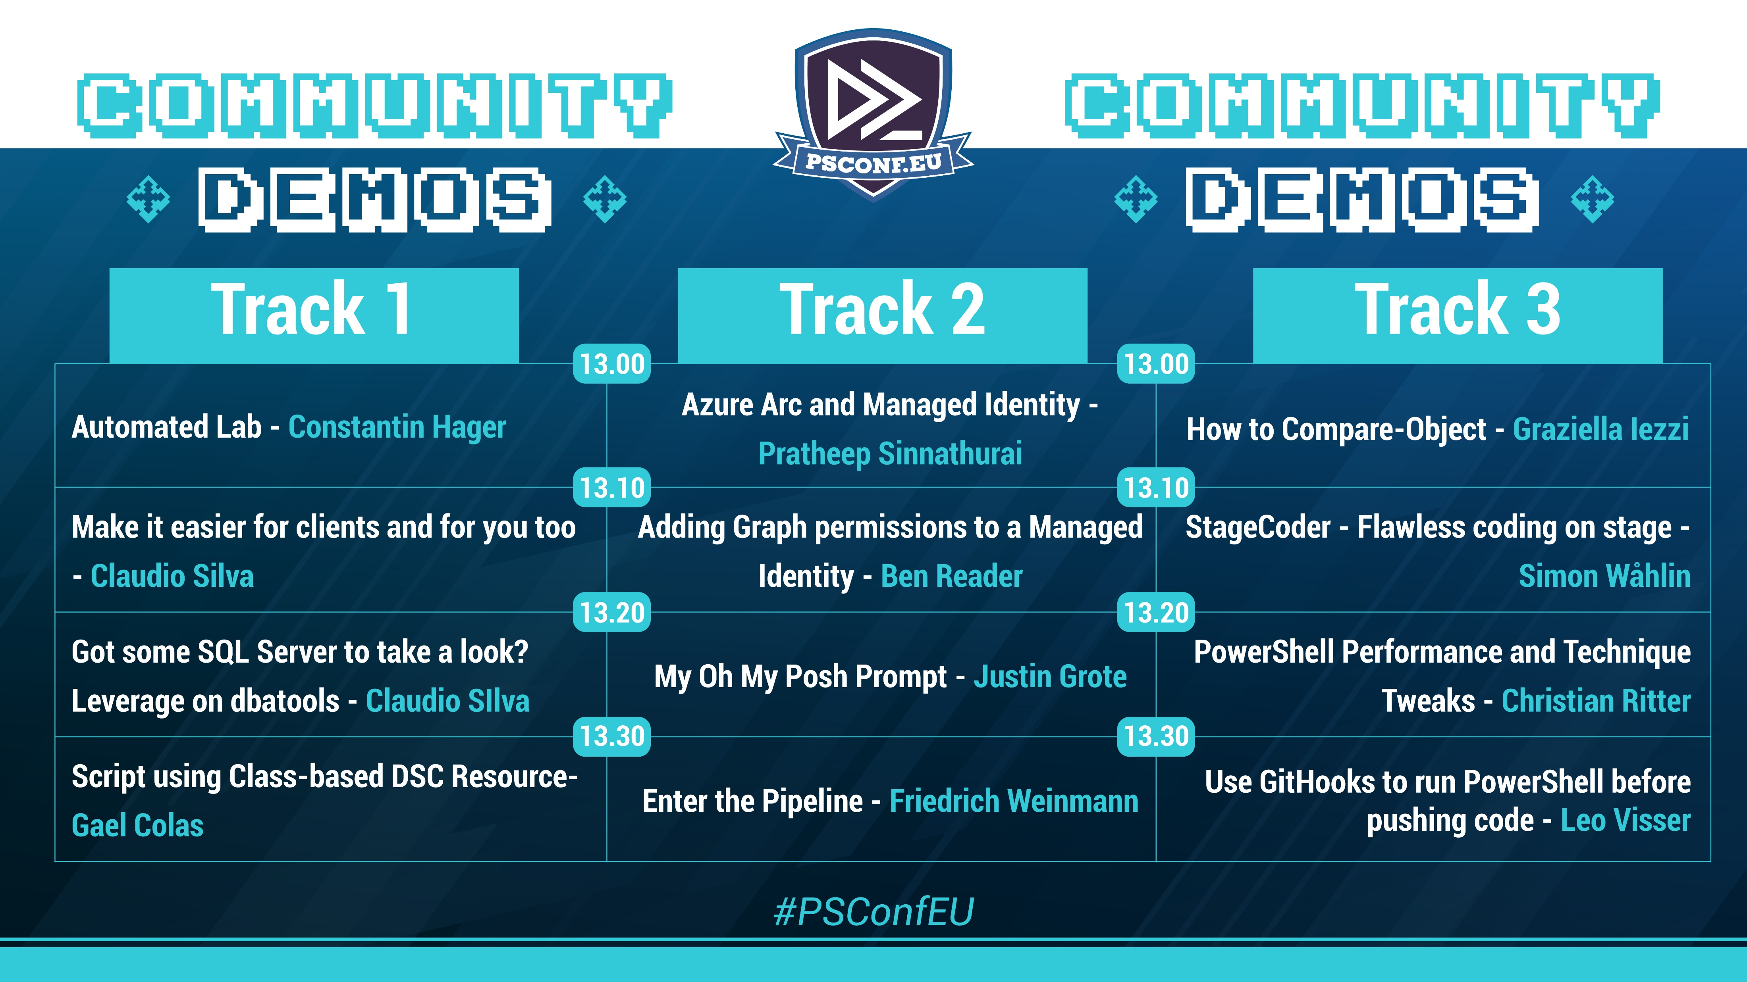

Slide 19

Donation
Inspire, train and guide new talents towards stronger diversity and competitiveness in tech
EUR 250
https://www.czechitas.cz/
THANK YOU

Slide 20


Manning preferential rate
35% discount code for all products in all formats: ctwpsconfeu23
http://mng.bz/pPOz

